Slide 1




Weekly report: Load & Dynamics
Week number: 06
Date: 04/11/2025
Supervisor: Mr. Manjock
Group members: Md Aman, Arham Memon, Paresh Nakum
Presenter – Md Aman
04/11/2025
Md Aman, Arham Memon, Paresh Nakum
Optimus Syria

Slide 2
Agenda For Loads & Dynamics
Normal turbulence model (NTM) Wind Field Simulation
Power curve
MExtremes
DLC 5.1
Simulation for DLC 5.1 Cases
Conclusion & Future Plan
Bibliography
04/11/2025
Md Aman
Load & Dynamics Team/ Optimus Syria

Slide 3
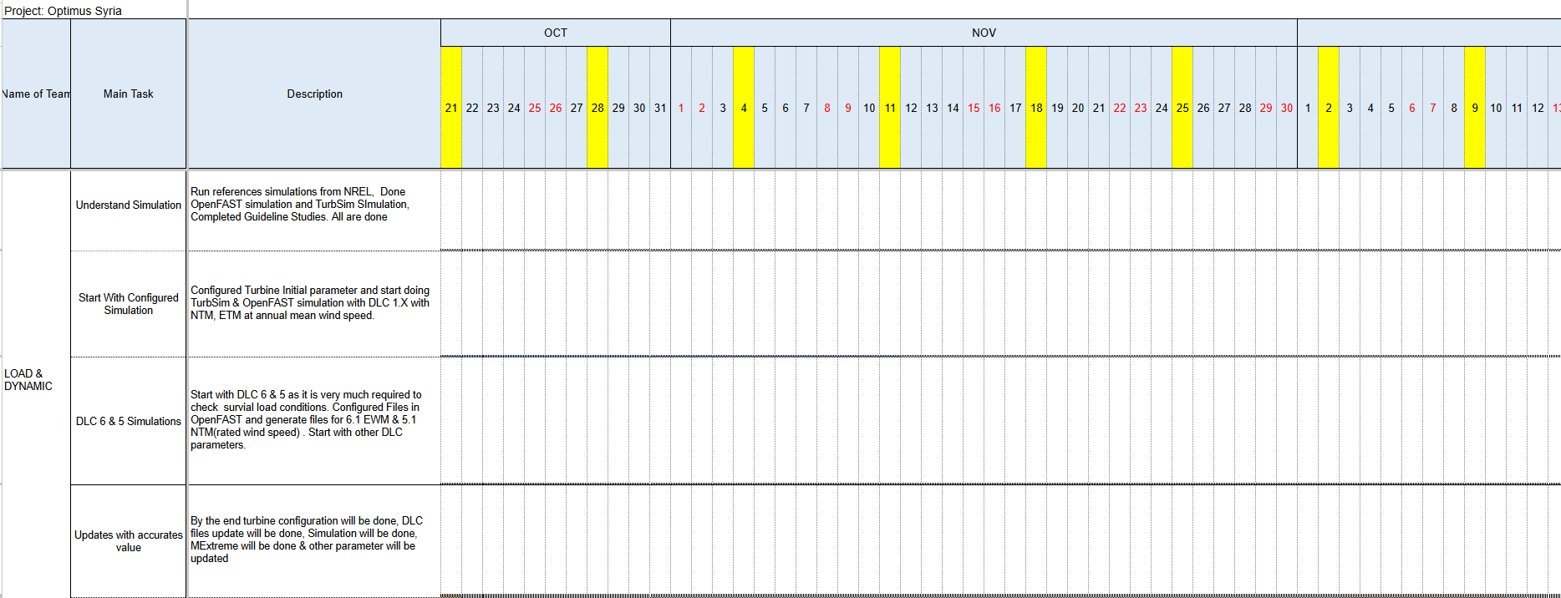
Timeline
DLC 5 with NTM & 6 with EWM
Other DLC cases analysis..
04/11/2025
Md Aman
Load & Dynamics Team/ Optimus Syria

Slide 4
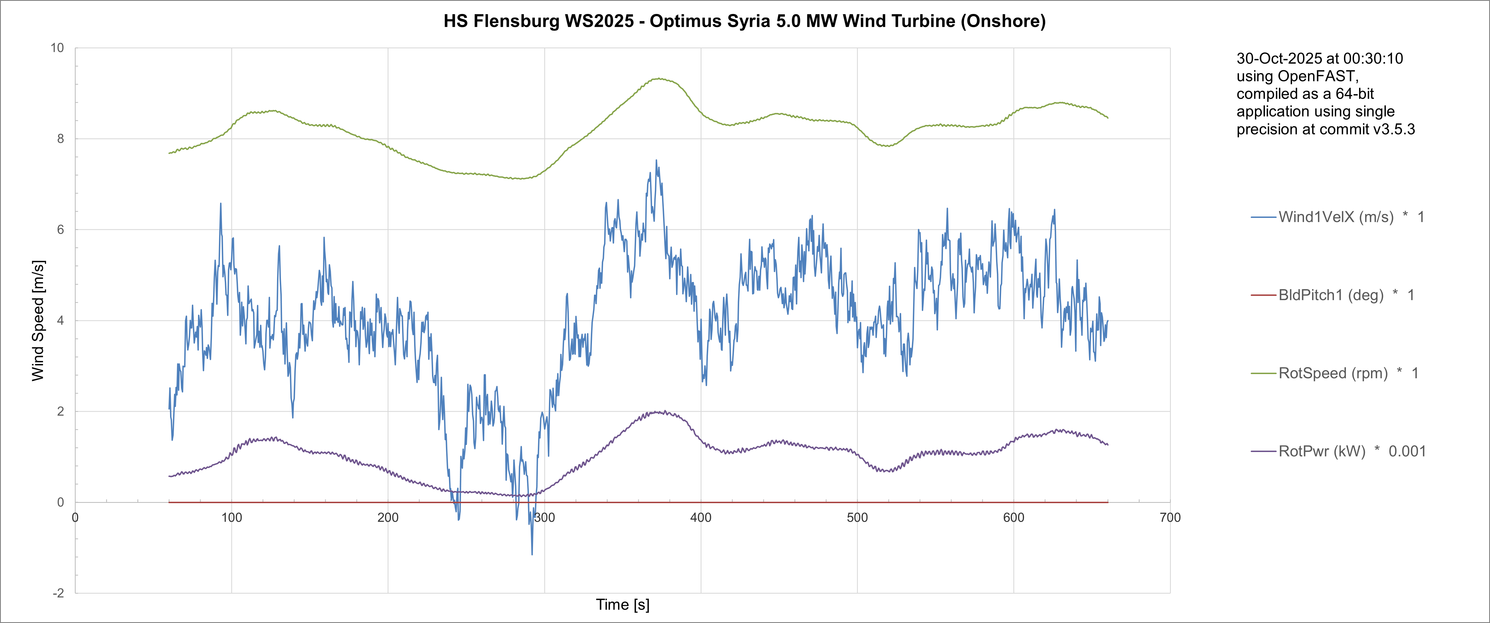
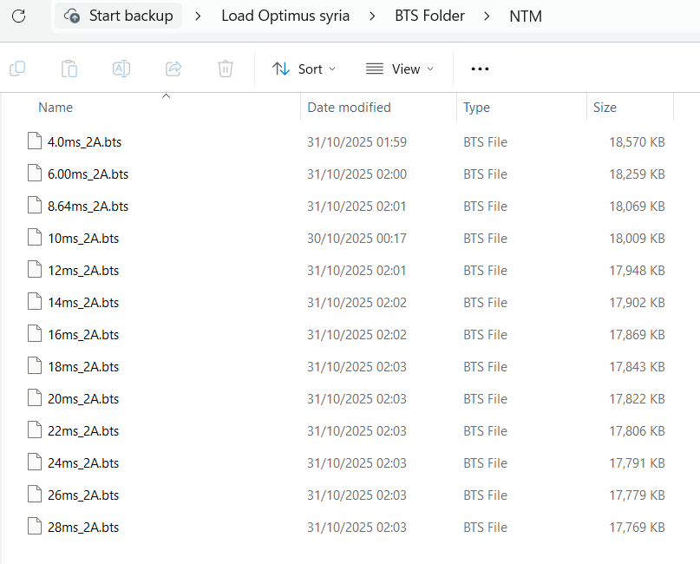
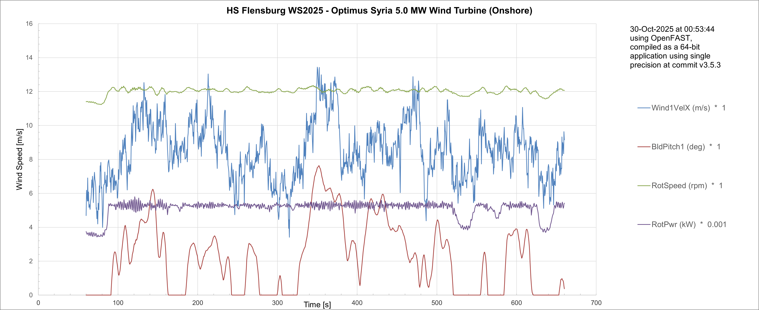
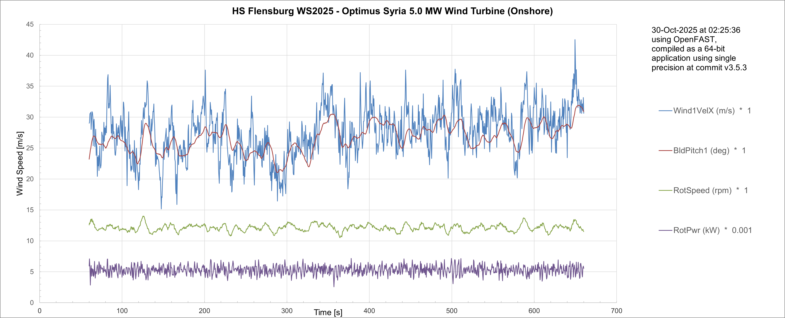
NTM Wind Field Simulations
4.0 m/s
Simulations at different Wind Speed in NTM
8.64 m/s
28.0 m/s
04/11/2025
4
Md Aman
Load & Dynamics Team/ Optimus Syria

Slide 5
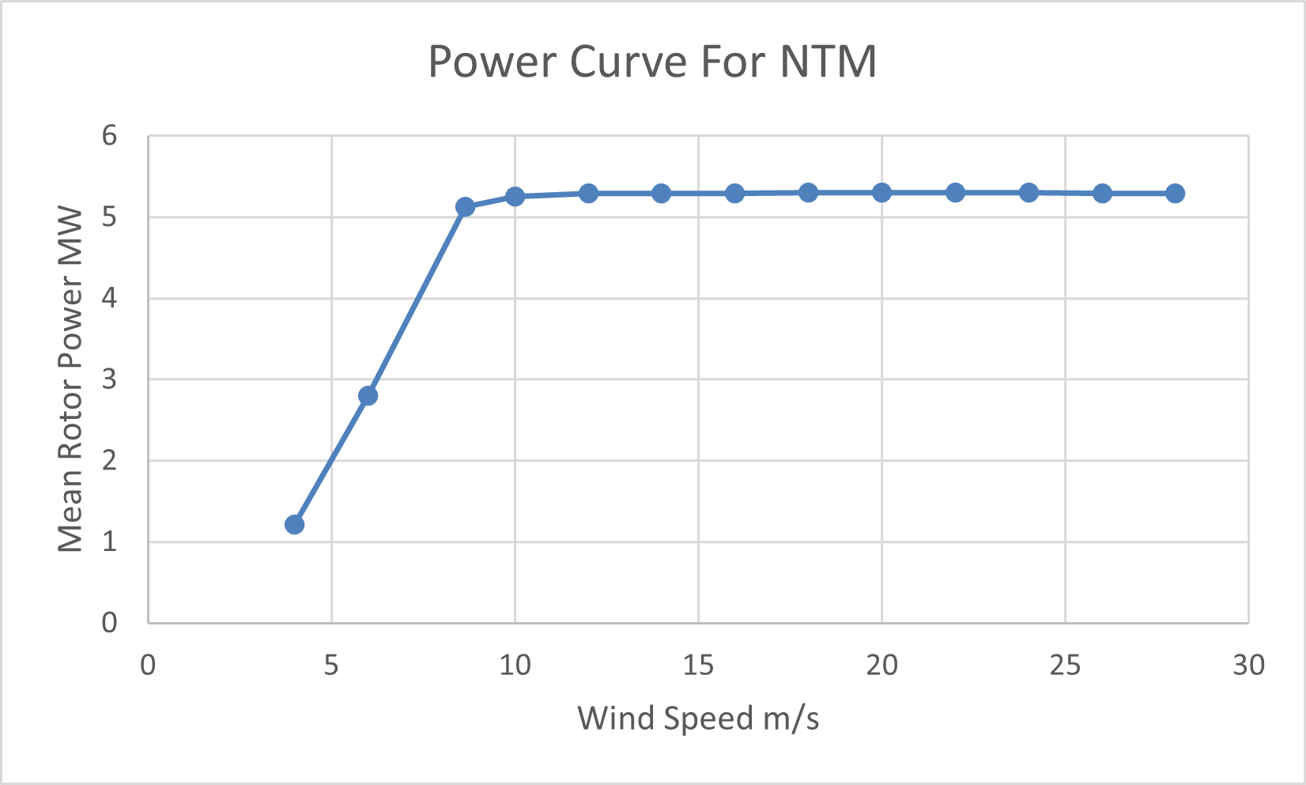
Power Curve for NTM
Simulations results at different Wind Speed in NTM
04/11/2025
5
Md Aman
Load & Dynamics Team/ Optimus Syria

Slide 6
MExtremes
MExtremes = Matlab tool for calculating load extremes (maximum/minimum values) from wind turbine simulations like OpenFAST.
Define Design Load Cases
(IEC 61400-1: DLC 1.x,2.x,3.x...)
Prepare input files
TurbSim or other tool → turbulence wind files.
OpenFAST input files (.fst) specifying DLC, controllers, initial conditions
Run OpenFAST simulations
Run one or many cases (each produces a time-series output .out
Collect and organize outputs
Gather .out files, label them by DLC and wind speed
Run MExtremes
Read files sequentially
Optionally use string channel names or calculated channels
Find extremes (max/min), record time, which file, and associated channels
Generate extreme-event tables & plots
Excel/text tables, charts, scatter plots, per DLC or wind-speed
Post-processing & checks
Apply partial safety factors (PSFs) if required
Compare extremes to design limits / safety factors
Certification / design decisionsReport results, pick critical load cases, update design if needed
04/11/2025
6
Md Aman
Load & Dynamics Team/ Optimus Syria

Slide 7
DLC 5.1
In IEC 61400-1 (Ed. 4, 2019), DLC 5.1 covers “Emergency Brake during operation”.
It’s one of the ultimate load cases, designed to check survival loads while Intense shut down.
Activity in Servodyn.dat file
Pitch action adjusted
Generator switch off
Disc brake application started
Case | Turbine State | Typical Wind Model
DLC 5.1 | Operation /power production plus activation of emergency brake procedure | NTM
DLC 5.1a | Rated wind speed ~ 10 m/s | NTM
DLC 5.1b | Rated wind speed + 2 m/s | NTM
DLC 5.1c | Rated wind speed - 2 m/s | NTM
DLC 5.1d | Cut-out wind speed - 28 m/s | NTM
04/11/2025
7
Md Aman
Load & Dynamics Team/ Optimus Syria

Slide 8
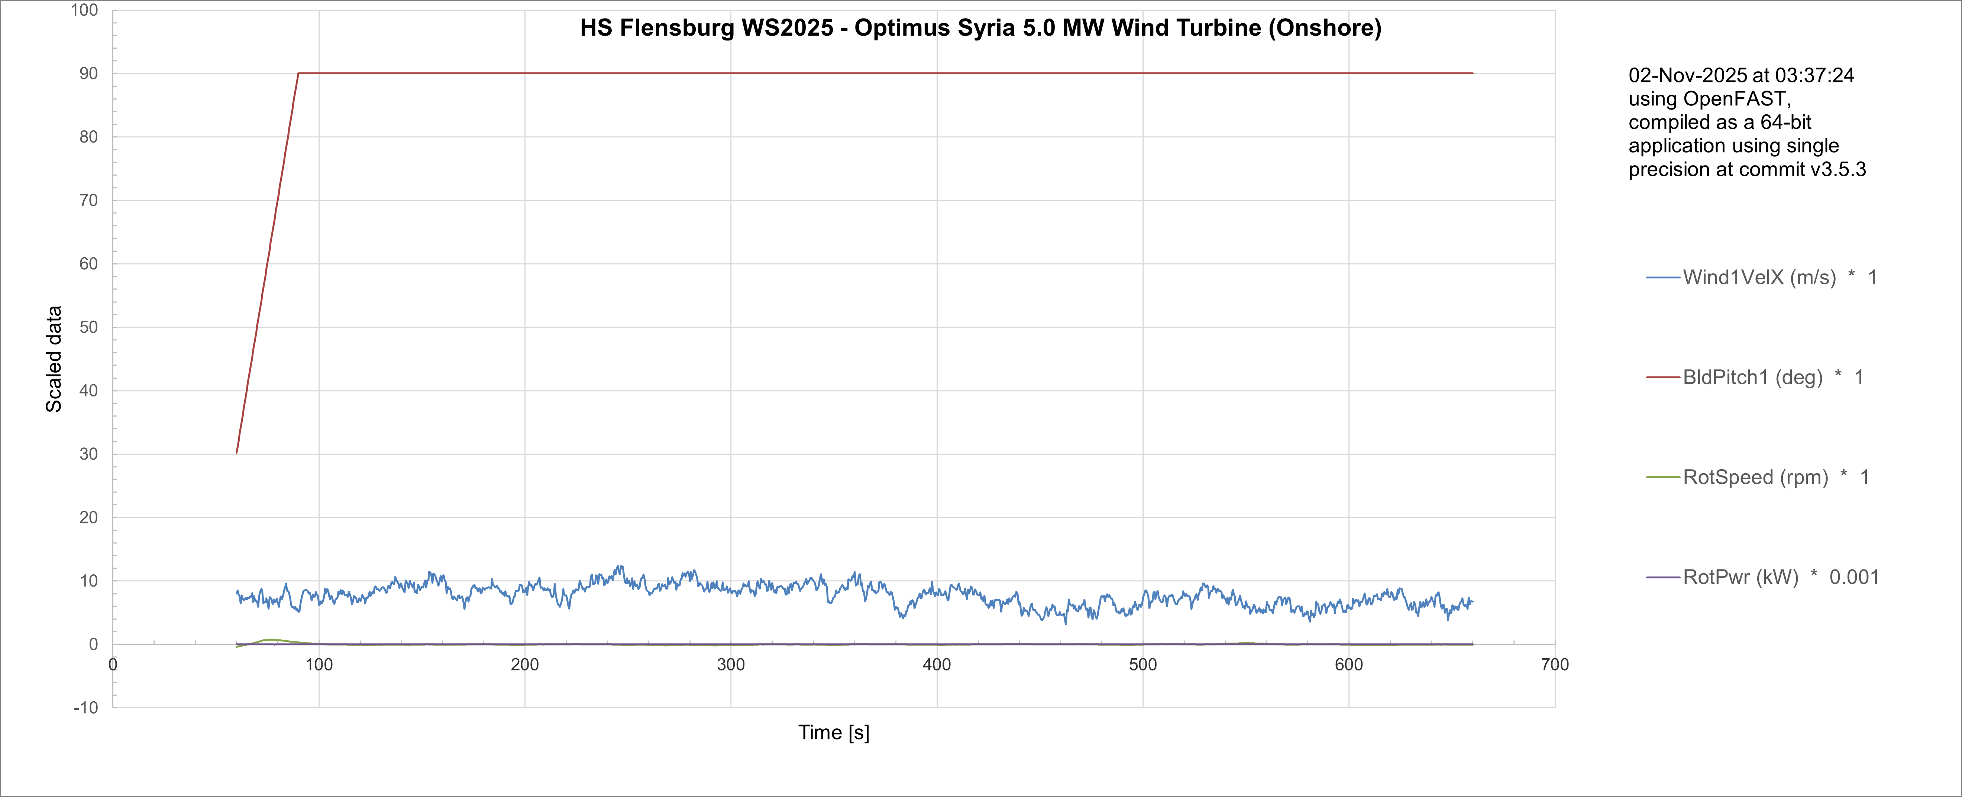
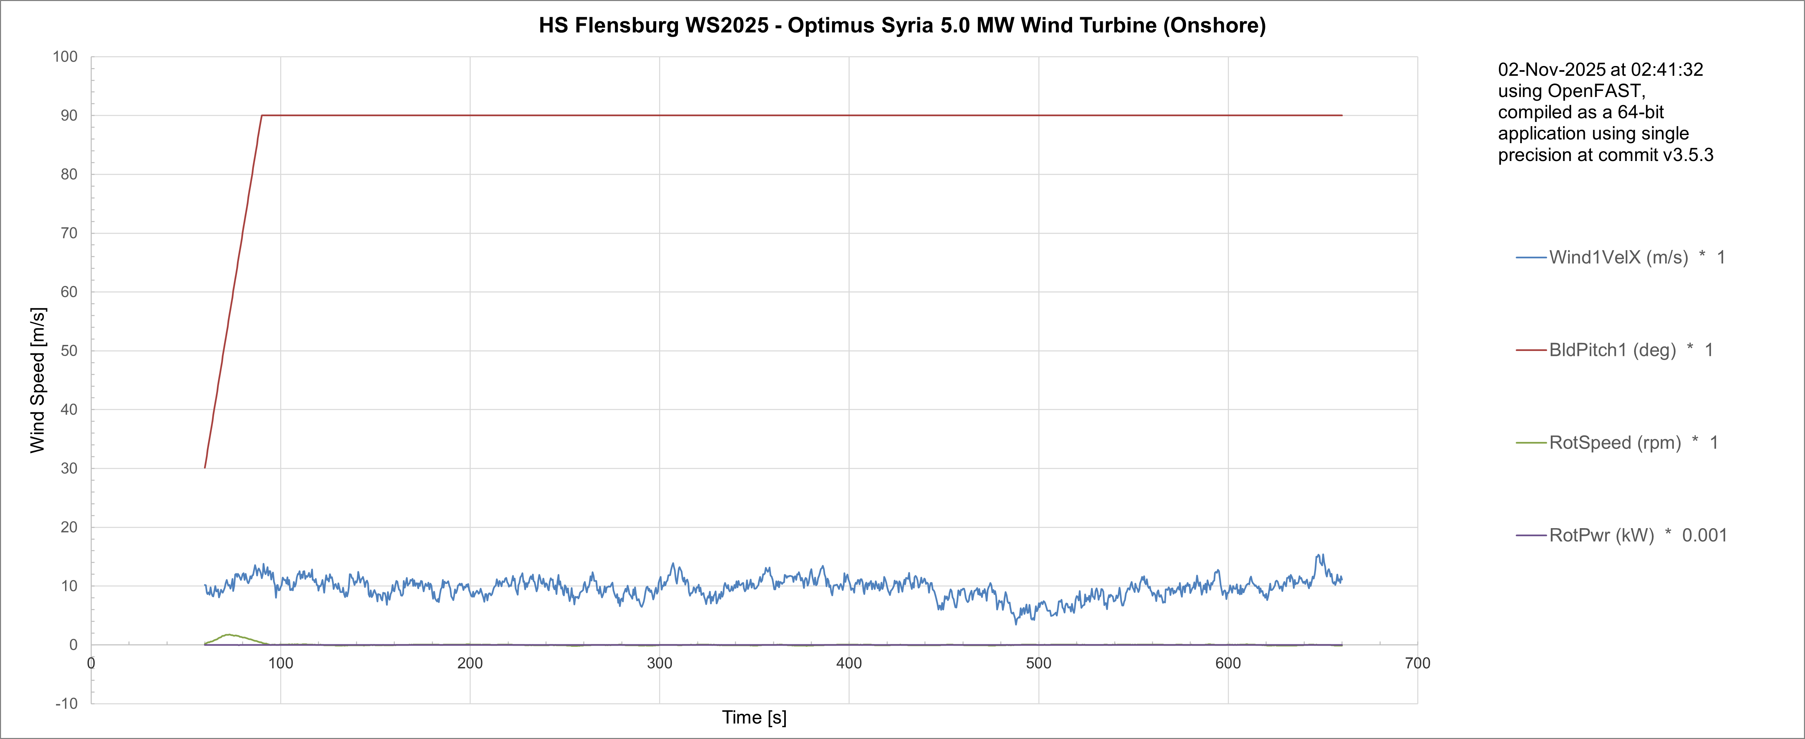
Simulation for DLC 5.1
8m/s
10m/s
04/11/2025
Md Aman
Load & Dynamics Team/ Optimus Syria

Slide 9
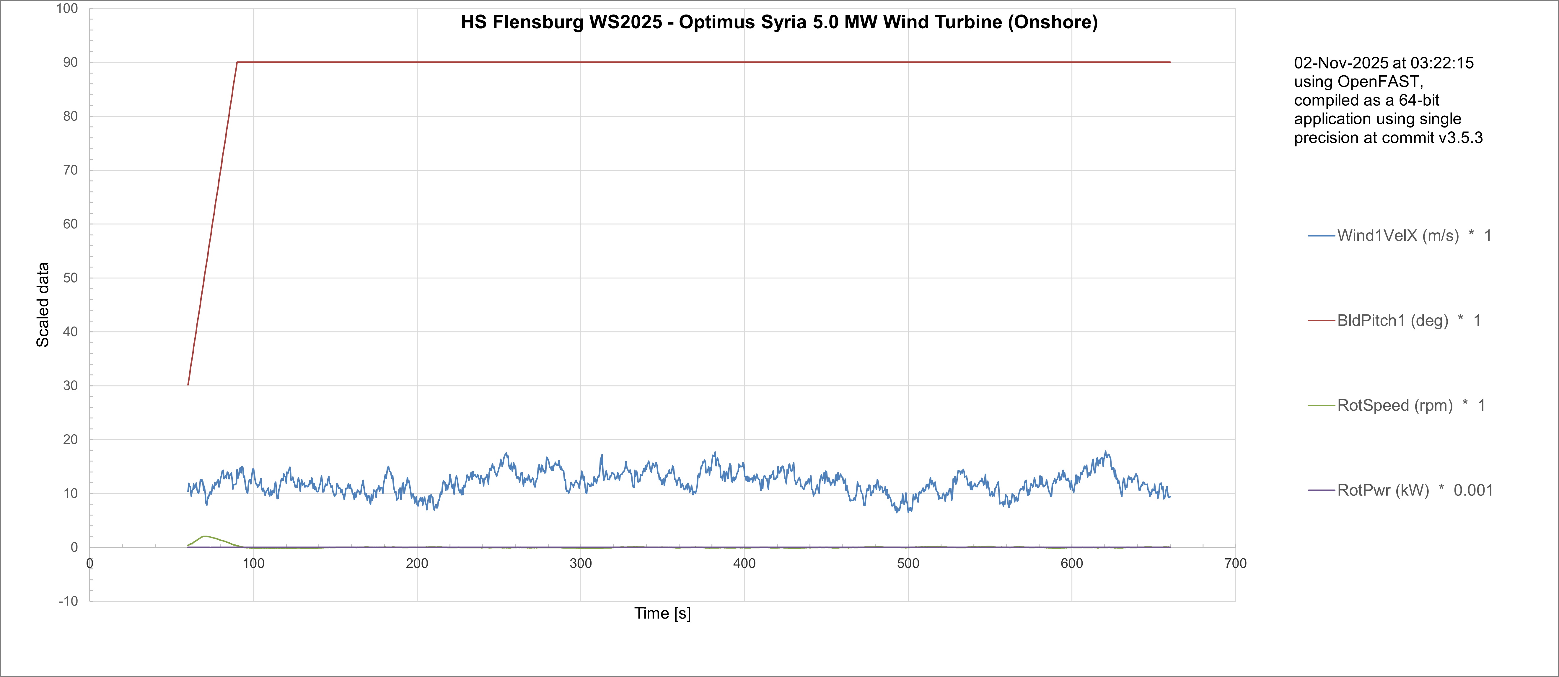
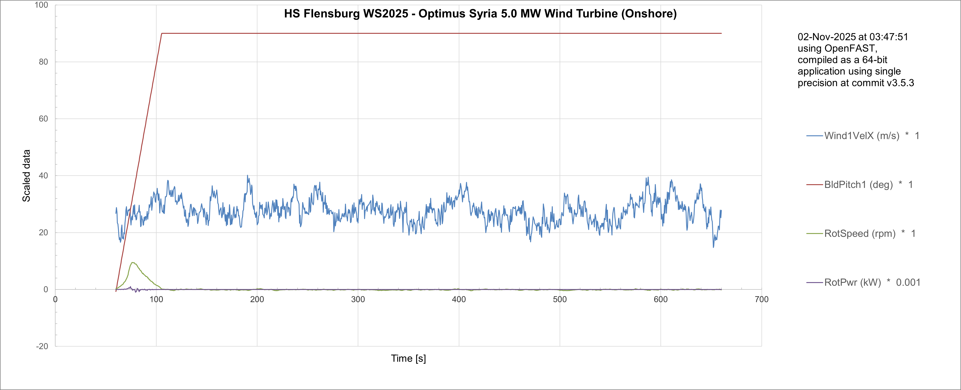
Simulation for DLC 5.1
12m/s
28m/s
04/11/2025
Md Aman
Load & Dynamics Team/ Optimus Syria

Slide 10
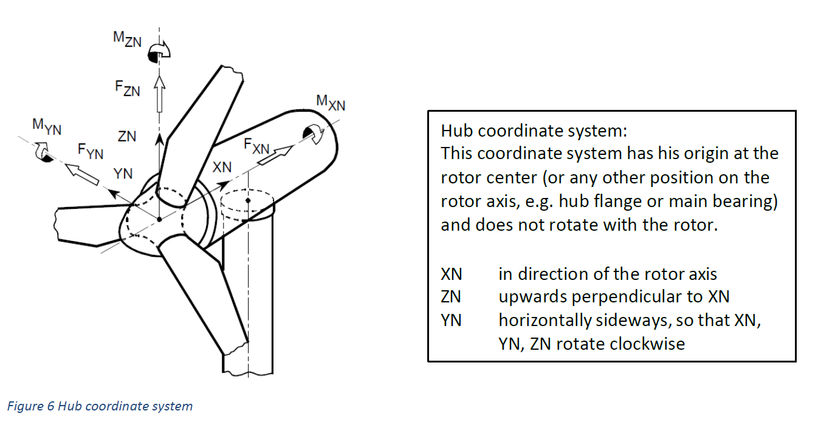
Conclusion & Future Plan
The hub coordinate system is used because it stays fixed with the nacelle, making rotor loads easy to interpret, sum, and transfer to the drivetrain and control systems — without the complication of rotating coordinates.
In the last week we
Configured Wind Simulations for NTM with different wind speeds
Configured Simulation with DLC 5.1
Understand use of MExtremes
Provided forces and moments at different section of turbine to other teams
In the next week
More simulations with DLC 5.1
Simulate OpenFAST for updated parameter of turbine
Configure Simulation with other DLC Cases
Work with different groups
Start Calculation of MExtremes
04/11/2025
10
Md Aman
Load & Dynamics Team/ Optimus Syria

Slide 11
References
Load Reports of the OPTIMUS projects
GL Guideline for the Certification of Wind Turbines Edition 2010
Loads and site conditions for wind turbines, DNVGL-ST-437,Edition November 2016
IEC 61400-1 2019-02, Ed. 4.0/ DNVGL-ST-0437 Loads and site conditions for wind turbines 11-2016
TurbSim, OpenFAST & NREL 5 MW
04/11/2025
11
Arham Memon
Load & Dynamics Team/ Optimus Syria

